Slide 1
Concurrency & Session
Denny, Bayu, Alfan

Slide 2
“Concurrency is one of the most tricky aspects of software development”

Slide 3
Concurrency Problem
Multiple processes or threads manipulating the same data
Difficult to enumerate the possible scenarios
Concurrency is hard to test for
Notes:
Karena scheduling dari operating system bisa berbeda2 dan kita tidak punya kontrol terhadap itu

Slide 4
Concurrency Problem
Developer use concurrency more yet worry about it less
Transaction managers
Transactions provide a framework that helps avoid many of the most tricky aspects of concurrency in an enterprise application
Still can’t ignore concurrency problems completely
Interactions with a system can't be placed within a single database transaction

Slide 5
Example of Concurrency Problem
Lost update problem
Uncommitted dependency problem
Inconsistent read

Slide 6
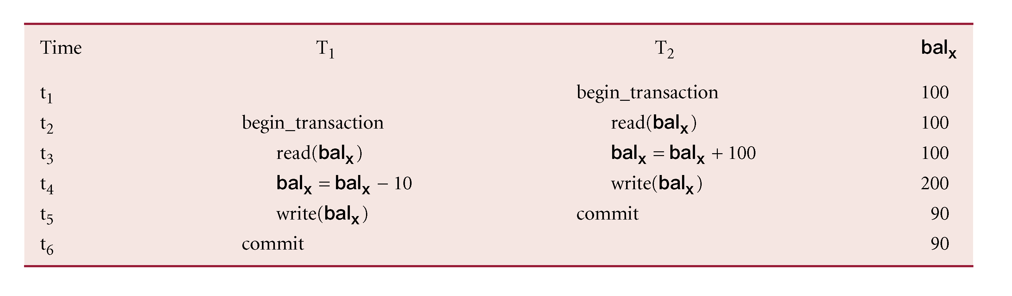
Lost Update Problem
Successfully completed update is overridden by another user.
T₁ withdrawing £10 from an account with bal_{x}, initially £100.
T₂ depositing £100 into same account.
Serially, final balance would be £190.
Loss of T₂’s update avoided by preventing T₁ from reading bal_{x} until after update.

Slide 7
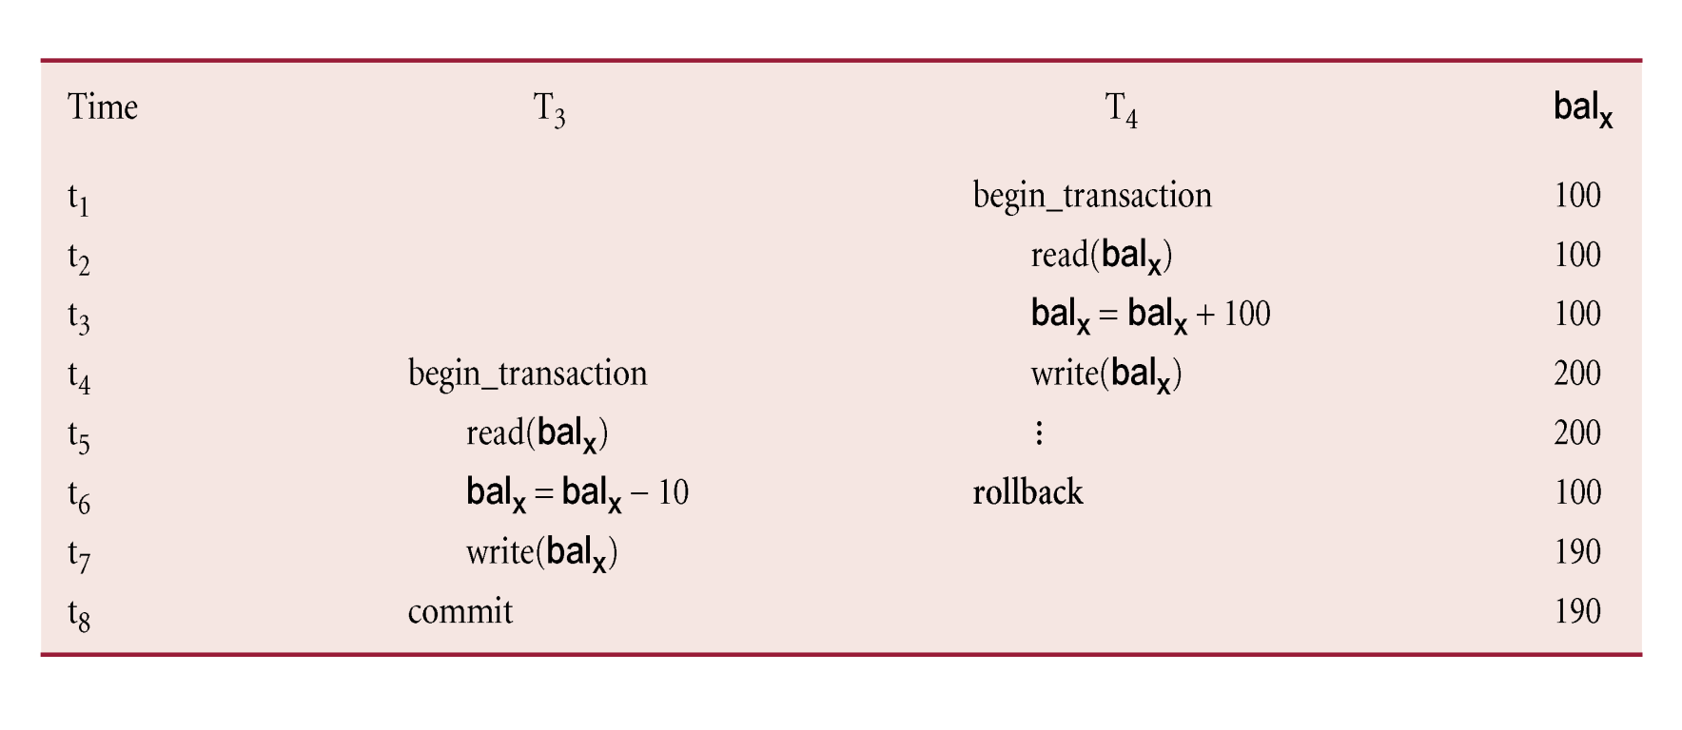
Uncommitted Dependency Problem (Dirty Read)
Occurs when one transaction can see intermediate results of another transaction before it has committed.
T₄ updates bal_{x} to £200 but it aborts, so bal_{x} should be back at original value of £100.
T₃ has read new value of bal_{x} (£200) and uses value as basis of £10 reduction, giving a new balance of £190, instead of £90.

Slide 8
Inconsistent Read
Occurs when transaction reads several values but second transaction updates some of them during execution of first.
Sometimes referred to as dirty read or unrepeatable read.
T₆ is totaling balances of account x (£100), account y (£50), and account z (£25).
Meantime, T₅ has transferred £10 from bal_{x} to bal_{z}, so T₆ now has wrong result (£10 too high).

Slide 9
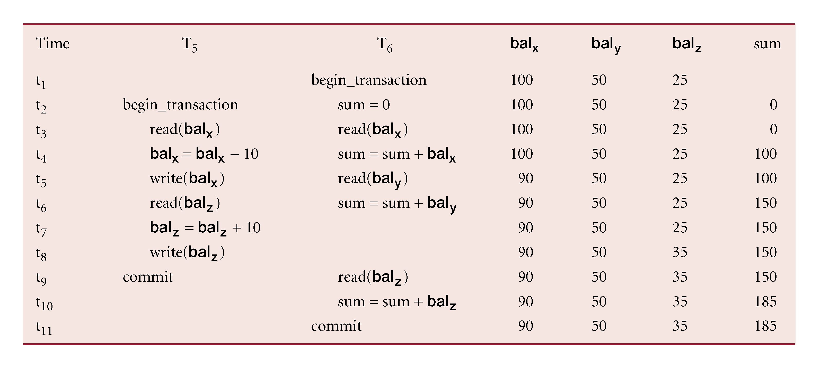
Inconsistent Read

Slide 10
Concurrency Problem
All of the problem mentioned above cause failure of correctness
They result in incorrect behavior that would not have occurred without two people trying to work with the same data at the same time
If correctness were the only issue, these problems wouldn't be that serious. We can use some technique
Serialization, Locking, Timestamp, etc.
The essential problem of any concurrent programming is that it's not enough to worry about correctness; you also have to worry about liveness
How much concurrent activity can go on

Slide 11
Isolation & Immutability
Concurrency problems occur when more than one active agent, such as a process or thread, has access to the same piece of data
Isolation: Partition the data so that any piece of it can only be accessed by one active agent
You only get concurrency problems if the data you're sharing can be modified
One way to avoid concurrency conflicts is to recognize immutable data
We can't make all data immutable. Identifying some data as immutable to relax concurrency concerns
Another option is to separate applications that are only reading data, and have them use copied data sources.

Slide 12
Optimistic & Pessimistic Concurrency Control
Let's suppose that Martin and David both want to edit the Customer file at the same time.
With optimistic locking both of them can make a copy of the file and edit it freely. If David is the first to finish, he can check in his work without trouble. The concurrency control kicks in when Martin tries to commit his changes. At this point the source code control system detects a conflict between Martin's changes and David's changes. Martin's commit is rejected and it's up to him to figure out how to deal with the situation.
With pessimistic locking whoever checks out the file first prevents anyone else from editing it. So if Martin is first to check out, David can't work with the file until Martin is finished with it and commits his changes.

Slide 13
Optimistic & Pessimistic Concurrency Control
Optimistic lock
conflict detection
provide merging mechanism?
use this technique if conflicts are sufficiently rare
Example : Git
Pessimistic lock
conflict prevention
reduces concurrency
Example : Visual Source Safe (around 2003)

Slide 14
Deadlock
Particular problem with pessimistic techniques
Martin is editing the Customer class file and David is editing the Order class file
What can cause deadlock here?
How to remedy this?
Notes:
Pick a victim
Timeout

Slide 15
Transaction
Example?
Definition for transaction:
Sequence of work
All resources are in a consistent state
Complete OR nothing basis

Slide 16
ACID
Atomicity
Consistency
Isolation
Durability
Notes:
Atomicity : No partial completion
Example for each of this?

Slide 17
Atomicity
Indivisible action
All or nothing at all
Should consider a lot of situation:
Power failures
Error
Crashes

Slide 18
Consistency
Bring the database from one valid state to another
What does “valid” mean?

Slide 19
Isolation
Concurrent execution of transaction results in a system state that would be obtained if transactions were executed sequentially.
Main goal of concurrency control

Slide 20
Durability
Once a transaction has been committed, it will remain so
Must be recorded in a non-volatile memory

Slide 21
Session State

Slide 22
Session State
In concurrency control, we raised the issue of the difference between business and system transactions
affects how to store the data that's used within a business transaction but isn't yet ready to be committed to the general database of record.

Slide 23
What is a session?
a semi-permanent interactive information interchange, also known as a dialogue, a conversation or a meeting, between two or more communicating devices, or between a computer and user

Slide 24
HTTP Cookie
Small piece of data sent by the web server and then stored at the user’s computer
Usage of Cookie?
Shopping Cart
Login/Authentication

Slide 25
The Value of Statelessness
Stateless server see an object that doesn't retain state between requests.
Stateful server persist all information between request
Imagine that you want to keep track of all the ISBNs visited by a particular client IP address
Stateful server keep this in a list maintained by the server object

Slide 26
Stateless vs Stateful
The primary issue is one of server resources
Any stateful server object needs to keep all its state while waiting for a user to ponder a Web page
Example:
We have a hundred people who want to know about books, and processing a request about a book takes one second
Each person makes one request every ten seconds, and all requests are perfectly balanced
If we want to track a user's requests with a stateful server object, we must have one server object per user: one hundred objects

Slide 27
Stateless vs Stateful
Many client interactions are inherently stateful
Example: Shopping cart
The user's interaction involves browsing several books and picking which ones to buy
Shopping cart needs to be remembered for the user's entire session

Slide 28
Session State
Session state is distinct from record data (data in database)
Record data is long-term persistent data held in the database and visible to all sessions
Session state needs to be committed to become record data
Not all data held by the session counts as session state
The session may cache some data that doesn't really need to be stored between requests but is stored to improve performance

Slide 29
Session State – Storing Data
Client Session State
stores the data on the client
encoding data in a URL for a Web presentation, using cookies, serializing the data into some hidden field on a Web form, and holding the data in objects on a rich client
Server Session State
holding the data in memory between requests
store as serialized object with session ID
store in server local filesystem
Database Session State
server-side storage
breaking up the data into tables and fields and storing it in the database much as you would store more lasting data

Slide 30
Client Session State - Problem
Bandwidth
Transfer data from client to server
Need to transfer data even it is not used in presentation
Security and Integrity
Encrypt the data
Malicious user still can edit your data

Slide 31
Database Session State
Session data has to be isolated
one session shouldn't affect what's going on in another
have to work hard to isolate the session data from the record data that sits in the database

Slide 32
Server Session State
Session migration
Implication for load balancing the request
When to purge the session data
Need to remove information for idle user?
Failure in the middle of transaction
Server/client crash, network connection error -> session data might be lost

